Slide 1


How Historians finds history
1
Introduction
Introduction
We know that our country India (known as bhāratavarṣa or aryavarta in ancient time) is surrounded by Himalaya, Arabian Sea, Bay of Bengal, Indian oceans in north, west, east, south respectively make India a peninsula. In this chapter we are going to learn how Indian history is organised, how historians know and what are the sources of historians and many more things.
Organising Indian History
In the book “The History of British India” James Mill written in 1817 AD classify Indian history into three division that were – Hindu, Muslim, and British (Christians) Time Period where these time period were named upon the religion which is the biggest limitation of this classification because whole time period can’t be named upon the ruler religion for example in Muslim period the citizens were not only Muslim and in British rule there were not only Christians. So due to the limitations of the classification of Indian history the historians divided Indian history into Ancient, Medieval and Modern History.
VIDYAVANTAM — CBSE CLASS 7 HISTORY
1
TRACING CHANGES THROUGH A THOUSAND YEARS

Slide 2

Indian History
Ancient
Medieval
Modern
Historians and their Sources
What were the sources that historians use to know what were before. These sources are classified into tow major divisions – Primary and Secondary sources
1
Primary Sources
A primary source is a first-hand or contemporary account of an event or topic. They are the most direct evidence of a time or event because they were created by people or things that were there at the time or event. These sources have not been modified by interpretation and offer original thought or new information. This includes Inscriptions, monuments, artefacts and coins, and the information available in them
Inscription
Writings engraved on rocks, pillars, metal plates, clay tablets, wall of temples, houses and tombs are called inscriptions.
VIDYAVANTAM — CBSE CLASS 7 HISTORY
2
TRACING CHANGES THROUGH A THOUSAND YEARS

Slide 3
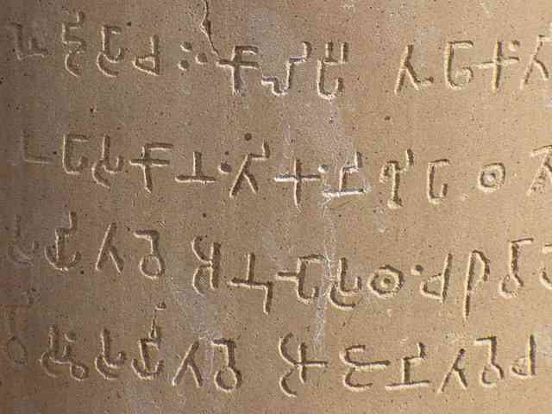
They tell us about the victories of rulers in battles or some occasions. The process of reading and understanding the script using in inscriptions is called as decipherment.
Inscription
Writings engraved on rocks, pillars, metal plates, clay tablets, wall of temples, houses and tombs are called inscriptions. They tell us about the victories of rulers in battles or some occasions. The process of reading and understanding the script using in inscriptions is called as decipherment.
An Ashoka inscription
Credit : Wikipedia
VIDYAVANTAM — CBSE CLASS 7 HISTORY
3
TRACING CHANGES THROUGH A THOUSAND YEARS

Slide 4
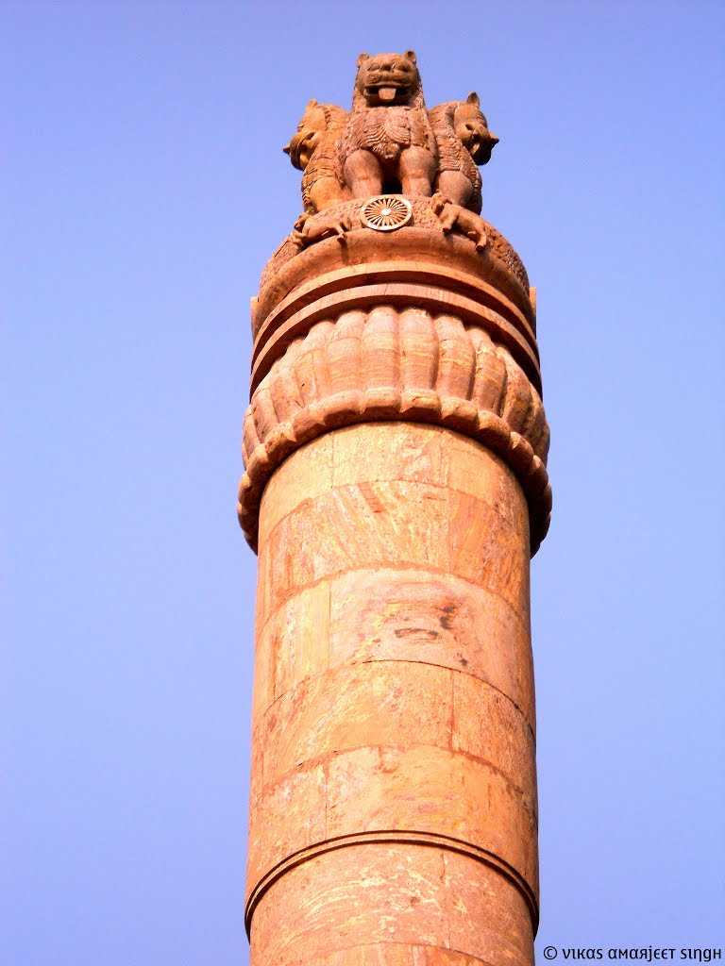
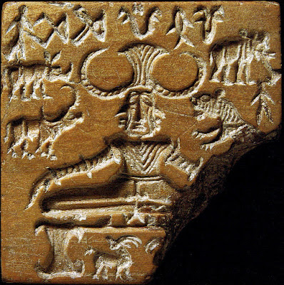
2. Monuments
Temples, forts, places and other structures built for some special purpose are called monuments. They tell us about the period which they were built, the artistic skills of that period, the religion that received the patronage of builders or rulers , etc. For Example Ashoka Pillar, Sanchi Stupa, Kailash Mandir at Ellora (largest monolithic (made from one stone) monuments in the world), etc.
Ashoka Pillar with 33 found inscription
3. Artefacts
Articles such as tools, weapons, pottery, tiny sculptures, toy, jewels, etc. made and used by people in the past are called artefacts. They give us vital clues about the past
4. Seals
Seals are objects with engraved emblem or stamp of authority like the seal of a yogi called Pashupati found on Indus Valley Civilisation.
A yogi called Pashupati Seal found in Indus valley civilisation
VIDYAVANTAM — CBSE CLASS 7 HISTORY
4
TRACING CHANGES THROUGH A THOUSAND YEARS

Slide 5
2
Secondary Sources
Literary works, chronicles, travelogues, biographies and autobiographies, etc. that provides information about history but are not the direct source.
Literary Sources
All written records of the past are literary sources. Most of the available literary sources of ancient history are manuscripts. Manuscripts were placed in libraries and archives. Before the invention of paper the manuscripts is written in on bhojapatra (birch bark) and palm leaves. The language of these manuscripts were generally Sanskrit and Prakrit and the script was Brahmi. Later Sanskrit adopted Devanagari as its script.
Religious Literature
Writing on religious themes are called religious literature. The Vedas, The Ramayana, The Mahabharata, Upanishads, Puranas, Geeta, which provide the wealth of knowledge about India’s ancient past and about the Hinduism
Secular Literature
The literature that is not connected with any religion is called secular literature such as Chand Bardai’s Prithiviraj Raso portrays the Rajput king’s valour. Madura Vijayam and Amuktamalyatha were poems composed by Gangadevi and Krishnadevaraya respectively that help us gain insight into the events and individuals associated with the Vijayanagara Empire. It includes the biographies of kings and books on politics and science. For examples are Indica written by Megasthenes, the accounts of Fa-Hien and Hiuen Tsang, Harshacharitra written by Banbhatta.
VIDYAVANTAM — CBSE CLASS 7 HISTORY
5
TRACING CHANGES THROUGH A THOUSAND YEARS

Slide 6
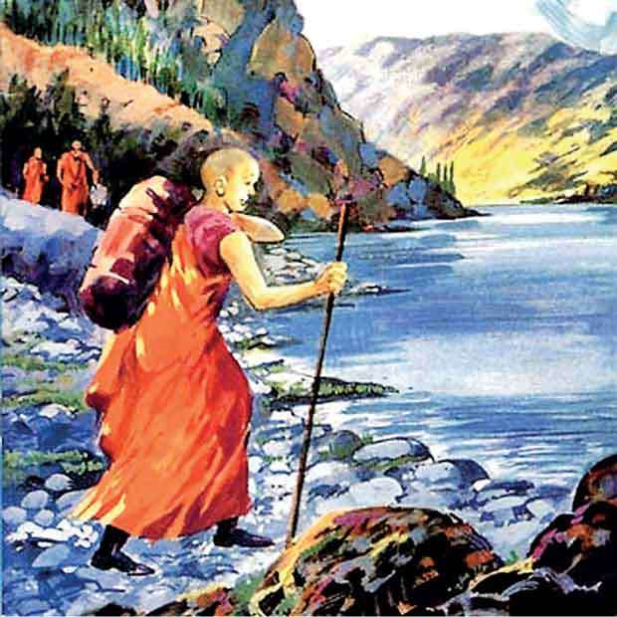
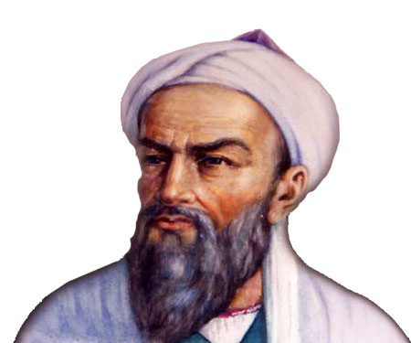
Travellers and Travelogues
Marco Polo
Marco Polo, a Venetian traveller, visited when the Pandya kingdom was becoming the leading Tamil power in the 13th century. Marco Polo was twice in Kayal, which was a port city (presently in Thoothukudi district of Tamilnadu). It was full of ships from Arabia and China. Marco Polo tells us that he himself came by a ship from China. According to Marco Polo, thousands of horses were imported into southern India by sea from Arabia and Persia.
Al-Beruni
Al-Beruni (11th century) accompanied Mahmud of Ghazni in one of his campaigns, and stayed in India for 10 years. The most accurate account of Mahmud’s Somnath expedition is that of Alberuni. As learned man and a scholar, he travelled all over India trying to understand India and her people. He learnt Sanskrit and studied the philosophy of India. In his book Tahquiq-i-Hind, Alberuni discussed the Indian conditions, systems of knowledge, social norms and religion.
And there were many travellers for example Ibn Battuta (14th century), Fa-Hien and Hiuen Tsang who wrote and describe India of that time
Fa Hien
Al Beruni
VIDYAVANTAM — CBSE CLASS 7 HISTORY
6
TRACING CHANGES THROUGH A THOUSAND YEARS

Slide 7
Mistakes in Sources
Have you ever thought that does all the sources are correct. Does the sources that historians read mislead them. There are so many historical sources that were wrong for instance Ghiazuddin Balban wrote in his inscriptions that his dynasty were from Ghazni (Gajjana) in Afghanistan in the west to Bengal (Gauda) in the east and included all South India which was wrong. And there is also many mistakes that is occurred while copying the sources. By saying this means there were no printers who can copy the pages multiple times without writing anything so there were a job named scribes who copy sources. But there were a problem if one copy source to first book but another copies the first copy but the another didn’t specific word and he wrote something else. There a small changes but if this cycle of writing mistakes continues the final copy that historians sees that will be different from the original source. This is a serious problem because we rarely find the original manuscript of the author today. We are totally dependent upon the copies made by later scribes. As a result historians have to read different manuscript versions of the same text to guess what the author had originally written.
VIDYAVANTAM — CBSE CLASS 7 HISTORY
7
TRACING CHANGES THROUGH A THOUSAND YEARS

Slide 8

Rashtrakuta, Pala, Gurjar Pratihar Dynasty
2
Introduction
Introduction
As we know that early medieval period (6th to 12th century) India was divided into many Dynasty and among these dynasties Rashtrakuta, Pala, Gurjar Pratihar dynasties are one of the major dynasties of Indian Medieval history. In this chapter we will learn about these dynasties in details.
Rashtrakuta Dynasty
Introduction
As we know that early medieval period (6th to 12th century) India was divided into many Dynasty and among these dynasties Rashtrakuta, Pala, Gurjar Pratihar dynasties are one of the major dynasties of Indian Medieval history. In this chapter we will learn about these dynasties, which monuments were built by these dynasties, how they disintegrate, etc.
VIDYAVANTAM — CBSE CLASS 7 HISTORY
8
RASHTRAKUTA, PALA, GURJAR PRATIHAR DYNASTY

Slide 9
Karkota Dynasty
3
Introduction
Introduction
Karkota Empire was a major power who ruled over the Kashmir valley and some northern parts of the Indian subcontinent during 625 CE - 885 CE. According to Hiuen -Tsang who visited Kashmir, the king ruled over parts of western and north western Punjab as well. The strongest ruler of Karkota Dynasty which is known as Alexander of Kashmir. We will know more about Karkota Dynasty in this whole chapter.
Establishment
Introduction
According to Rajtarangani (Sanskrit – The rivers of kings) which was written by Kalhana in 12th century, Karkota Dynasty was established by Durlabhavardhana in 625 AD. Durlabhavardhana works as a loyal officer for Gonanda’s Dynasty’s last ruler Baladitya. Baladitya got his daughter Ananglekha married to Durlabhavardhana and then Durlabhavardhana started Karkota Dynasty in 625 CE. Since Durlabhavardhana was Kayastha, Karkota dynasty is also known as Karkota Kayastha Dynasty.
VIDYAVANTAM — CBSE CLASS 7 HISTORY
9
KARKOTA DYNASTY

Slide 10
Rulers of Karkota Dynasty
Introduction
The series of rulers of Karkota Dynasty are:-
Durlabhavardhana
Durlabhaka
Chandrapida
Tarapida
Lalitaditya Muktapida
Kuvalayapida
Vajraditya
Jayapida
Lalitapida
Samgramapida II
Brihaspati
1
Durlabhavardhana
Durlabhavardhana was the first ruler of Karkota Dynasty which was a loyal officer of Gonanda’s Dynasty’s ruler Baladitya. Baladitya got his daughter Ananglekha married to Durlabhavardhana and after Baladitya death Durlabhavardhana started Karkota (named after his father Karkotaka) Dynasty in 625 CE. According to Kalhana he ruled with a span of about 36 years from 625 AD to 661 AD. Xuan Zang have visited Kashmir twice and according to him, Durlabhavardhana controlled vast swaths of territories including modern day Kashmir, Punjab and Khyber Pakhtunkhwa (Pakistan’s huge area). In Durlabhavardhana rule, Kashmir was the centre of Learning and Science.
2
Durlabhaka
As per Kalhana, Dulabhaka or Pratap Aditya ruled with a
VIDYAVANTAM — CBSE CLASS 7 HISTORY
10
KARKOTA DYNASTY

Slide 11
span of 50 years from 662 AD to 712 AD. His reign saw increasing trade relation with neighbouring polities and the development of the Classical Kārkoṭa style of sculpture. Kalhana records him to have impressive military skill. In his rule many Agrahara was settled. An Agraharam or Agrahara was a grant of land and royal income from it, typically by a king or a noble family in India, for religious purposes, particularly to Brahmins to maintain temples in that land or a pilgrimage site and to sustain their families.
Durlabhak married Narendraprabhā, and had three sons - Chandrapida, Tarapida and Lalitaditya Muktapida
3
Chandrapida
When the Durlabhak died in 712 AD the next king was Chandrapida who ruled for about 8 years from 712 AD to 720 AD. Chandrapida is also mentioned in Chinese Tang Dynasty history because In 713, Emperor Xuanzong of Tang received an embassy from Chandrapida requesting aid against Arab invasions. Chandrapida didn’t receive any response but defend Arab invasions from his territory. In 720 AD, Xuanzong sent an envoy to bestow upon him, the title "King of Kashmir“. These diplomatic exchanges led to the formation of an imperial alliance between the Tangs and Karakotas.
4
Tarapida
Tarapida ruled only for about 4 years from 720 AD to 724 AD. In Rajtarangani this is mentioned in his rule he was tyrannical and oppressed the Brahmins.
5
Lalitaditya Muktapida
Lalitaditya Muktapida was the greatest ruler of Karkota
VIDYAVANTAM — CBSE CLASS 7 HISTORY
11
KARKOTA DYNASTY

Slide 12
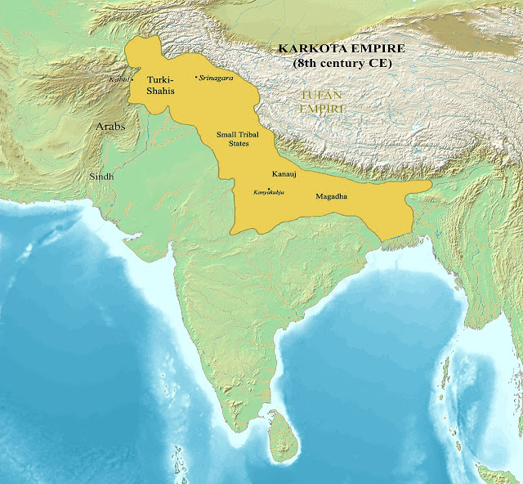
Dynasty and one of greatest king of Indian History. In Indian history Lalitaditya Muktapida is mainly mentioned in Rajtarangani. Lalitaditya Muktapida is mention in Chinese History. Lalitaditya Muktapida ruled for about 36 years from 724 AD to 760 AD. This is said that his rule was the golden time of Kashmir because at that time architecture, art, science, culture was very promoted by him. Due to his victorious rule he is also known as Alexander of Kashmir. Parihasapura was built by Lalitaditya and served as a capital during his reign.
Extent of Karkota Empire in Lalitaditya reign
VIDYAVANTAM — CBSE CLASS 7 HISTORY
12
KARKOTA DYNASTY

Slide 13
Conquers by Lalitaditya
In 740 AD he defeated Yashovarman (king of Kannauj)
He defeated Gauda Dynasty’s ruler Naresh (king of Bengal) and won Bengal.
Then he moved to South India and won more areas from South India.
This was the time when Muhammad Bid Qasim had invaded Multan and Arabic invaders wanted entire India to be subjected under the Islamic Fold.
But before fight over the Islamic Invader king Lalitaditya first won Tibetan invaders with also with the help of Bapppa Rawal (Mewar Dynasty). According to Al-Beruni, Kashmir people celebrate the victory of Lalitaditya over Tibet on 2nd day of Chaitra every year. Soon after, Junaid, the Arab governor of Sindh, attacked Kashmir on the order of Calipha Hisham, after the death of Muhammad, four major Caliphates were established, Umayyad was the second Caliphates which was held from Mecca. The Arabs had established their rule over Sindh. And then they looked at Kashmir as it was prosperous region. Lalitaditya defeated Junaid and the Arab attempt of plundering Kashmir failed. And they didn’t attack Kashmir till he was alive.
Lalitaditya also won over Central Asia, which comprises modern day countries like Uzbekistan, Tajikistan, South Kyrgyzstan and southwest Kazakhstan.
After that he invaded Turkistan through Kabul and defeated Momin from Bukhara in all the four wars. He expanded his territories consequently to the Caspian sea.
He used to be so furious with the Arabs for invading his country that he ordered the prisoners of war to be sent back with half of their heads shaven.
VIDYAVANTAM — CBSE CLASS 7 HISTORY
13
KARKOTA DYNASTY

Slide 14
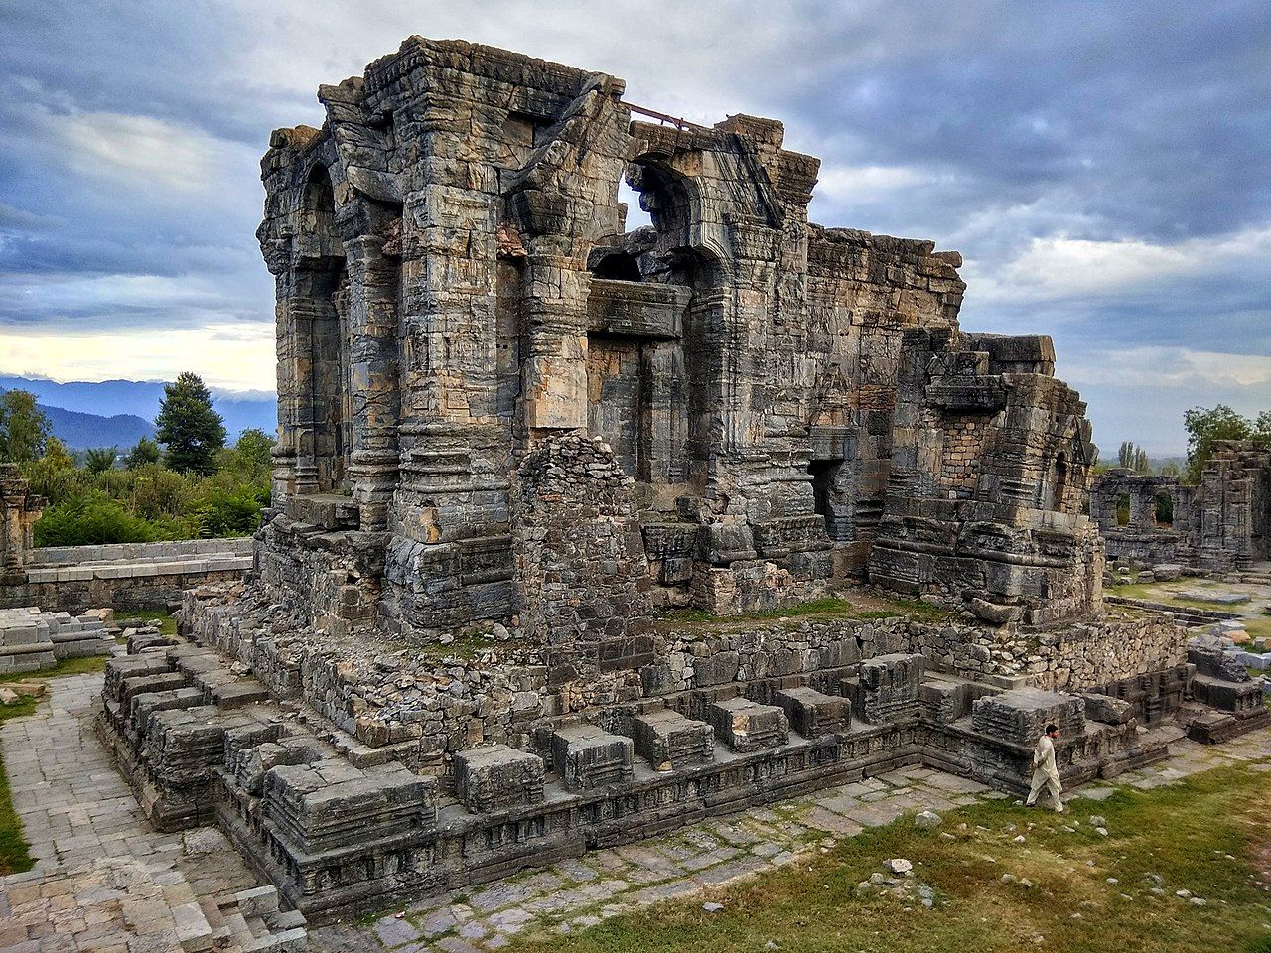
He expanded Kashmir from Tibet in the north to Dwarka and Odisha in the south, from Bengal in the east, to central Asia in the west, Lalitaditya's empire had been established with supreme might. He had almost reached Aranayaka Kingdom (Modern day Iran).
Monuments by Lalitaditya
Lalitaditya made Martanda Surya Mandir (Martanda Sun Temple) at Anantnag, Kashmir which was destroyed by Sikandar Shah Miri (Sikandar Butshikan) in 12th century and this is said that the time taken by Sikandar Butshikan was about 1 years. In his capital Parihasapura, he made many temples, a palace for him, many libraries and a Chaitya. Among them Parihasakeshava temple, Govardhanadeva temple and Mahavaraha temple was major temples which was destroyed by other Islamic Invaders.
Martanda Surya Temple
VIDYAVANTAM — CBSE CLASS 7 HISTORY
14
KARKOTA DYNASTY

Slide 15
Wonders by Lalitaditya
An idol of Parihasapura-Keshava, made of 3600 kgs silver
An idol of Mukta-Keshava, made of 979 kgs of gold
An idol of Nṛhari which was suspended in air by fixing magnets above and below of it.
Raised a pillar which measured 54 hands in height, and had an image of Garuda (Vishnu's vahana) at the top.
A large statue of Buddha made of 62000 kgs of Copper.
There is no valid statement that states how Lalitaditya Muktapida died. But after the death of Lalitaditya Muktapida the next ruler of Karkota dynasty was his son named Kuvalayapida. After Kuvalayapida next ruler was Vajraditya. After Vajraditya the major ruler was Jayapida (son of Vajraditya).
6
Jayapida
Jayapida ruled for 31 years from 779 AD to 813 AD. In his rule, From Sindhu river’s area to South India, Brahmins were settled in Kashmir. Kalhana notes his later years to be tyrannical when Jayapida imposed a cruel taxation regime on Brahmins, forcing them to emigrate; he was cursed to death by a Brahmin. Jayapida had two sons — Lalitapida and Samgramapida II.
After Jayapida next ruler was Lalitapida (813 AD to 825 AD) and after that the next ruler was Samgramapida II (825 AD to 832 AD). After Samgramapida II the ruler was the son of Jayapida’s son named Chipattajayapida
VIDYAVANTAM — CBSE CLASS 7 HISTORY
15
KARKOTA DYNASTY

Slide 16
7
Chipattajayapida
Chipattajayapida (Brihaspati) was the last ruler of Karkota Dynasty. Due to his young age, the real power was vested in the five brothers of Jayadevi (his mother) — Padma, Utpala, Kalyana, Mamma, and Dharma — who followed the orders of Jayadevi but yet engaged in an acute mismanagement of affairs.
Declination of Karkota Dynasty
Introduction
Chipattajayapida was murdered in 850 C.E. after ruling for about 12 years. Thereon all the five brothers of Jayadevi installed puppet rulers who ruled for short spans of time before being deposed and replaced by another puppet ruler. Utpala's son Sukhavarmana sought to take the throne for himself but was killed by one of the brothers. Finally, Sukhavarmana son Avantivarmana took the throne and established the Utpala dynasty (started in 855 AD) which was one of the major dynasty of Kashmir.
VIDYAVANTAM — CBSE CLASS 7 HISTORY
16
KARKOTA DYNASTY

Slide 17
Chalukya and Pallava Dynasty
4
VIDYAVANTAM — CBSE CLASS 7 HISTORY
17
TRACING CHANGES THROUGH A THOUSAND YEARS

Slide 18
Chola Dynasty
5
VIDYAVANTAM — CBSE CLASS 7 HISTORY
18
TRACING CHANGES THROUGH A THOUSAND YEARS

Slide 19
Ganges Dynasty
6
VIDYAVANTAM — CBSE CLASS 7 HISTORY
19
TRACING CHANGES THROUGH A THOUSAND YEARS

Slide 20
Invaders and The Delhi Sultanate
7
VIDYAVANTAM — CBSE CLASS 7 HISTORY
20
TRACING CHANGES THROUGH A THOUSAND YEARS

Slide 21
The Mughal Empire
8
VIDYAVANTAM — CBSE CLASS 7 HISTORY
21
TRACING CHANGES THROUGH A THOUSAND YEARS

Slide 22
Mewar Kingdom
9
VIDYAVANTAM — CBSE CLASS 7 HISTORY
22
TRACING CHANGES THROUGH A THOUSAND YEARS

Slide 23
Maratha Empire
10
VIDYAVANTAM — CBSE CLASS 7 HISTORY
23
TRACING CHANGES THROUGH A THOUSAND YEARS

Slide 24
Vijayanagara Empire
11
VIDYAVANTAM — CBSE CLASS 7 HISTORY
24
TRACING CHANGES THROUGH A THOUSAND YEARS

Slide 25
Ahom Kingdom
12
VIDYAVANTAM — CBSE CLASS 7 HISTORY
25
TRACING CHANGES THROUGH A THOUSAND YEARS

Slide 26
Sikh Empire
13
VIDYAVANTAM — CBSE CLASS 7 HISTORY
26
TRACING CHANGES THROUGH A THOUSAND YEARS

